Slide 1

XG Boost
Algorithm
SOWMIYA R A

Slide 2
XGBoost, short for eXtreme Gradient Boosting, is a powerful machine learning algorithm known for its efficiency, speed, and accuracy.
It belongs to the family of boosting algorithms, which are ensemble learning techniques.
It combine the predictions of multiple weak learners.
it can handle large datasets in a variety of machine-learning tasks, including regression and classification.

Slide 3



When not to use XG Boost?
1. Limited training samples.
2. Image recognition and Natural Language Processing tasks.
3. Unstructured Data

Slide 4
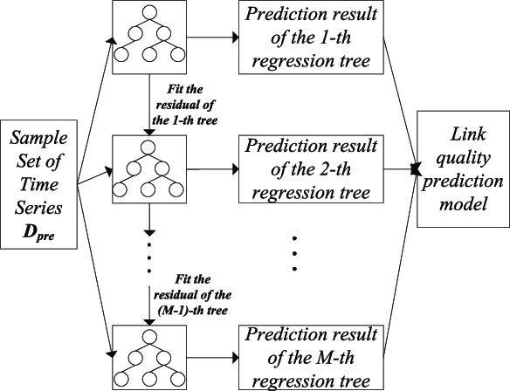



Slide 5

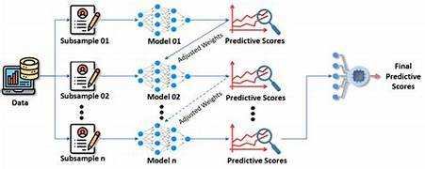
XGBoost constructs trees level by level, assessing whether adding a new node (split) enhances the objective function as a whole at each level. The split is trimmed if not. This level growth along with trimming makes the trees easier to understand and easier to create
XGBoost remains a strong choice, where only numeric features are present. Its effectiveness in handling numeric data, coupled with regularization techniques, contributes to robust model performance

